Slide 1
Modern Slavery and Human Trafficking
GSC: OFFICIAL

Slide 2
Modern Slavery
Modern slavery is a significant threat linked to serious organised crime groups (OCGs). These groups deliberately target vulnerable individuals, exploiting them for profit through coercion, control, and deception.
Understanding how this exploitation occurs is key to prevention and safeguarding.

Slide 3
Vulnerability, control and cooperation
Common vulnerability factors… | Common control factors… | Cooperation influenced by…
Learning difficulties. Substance misuse. Poverty / lack of finance. Social isolation. Looked after or in care. Excluded from school. Family breakdown. Immigration status. Lack of education. Age. Language. Homelessness. Mental health. Lack of employment opportunity. | Threat / use of violence . Financial control. Isolation. Debt bondage. Sexual abuse and exploitation. Blackmail. Intimidation. Removal of ID documents. Removal of bank cards / access to funds. Induce fear of authorities. | Unaware they are a victim. Unaware of support available. Language barriers. Control. Fear of repercussions. Isolation. Exploited lifestyle is better than alternative. Immigration status. Involvement in criminal activity. Lack of trust in authorities. Self blame. Stigma. Stockholm syndrome.

Slide 4
Signs of exploitation: Can you spot the signs of modern slavery?
Sexual Exploitation They may appear scared or intimidated Appearing frightened, withdrawn or confused They’re closely guarded Are unable to keep payment and have restricted or no access to their earnings Have limited English vocabulary, restricted to sexualised words Male visitors call day and night and who only stay for a short time A number of female foreign nationals living at the same address Frequent turnover of occupants | Labour Exploitation They appear to not be free to move and/or are always accompanied They’re transported to and from work, perhaps with a number of people in one vehicle Lack protective equipment, suitable clothing or training to safely do their job Lack access to their own documents, such as ID or passport; an employer may have confiscated them Working unusually long hours. They do not have a contract, are paid less than the National Minimum Wage, or not paid at all Forced to stay in accommodation provided by their employer; this may be overcrowded Afraid to accept money or payment Their legitimate wages may be taken by an exploiter who is outside of the business or workplace
Criminal Exploitation A large group of adult or child beggars being moved daily to different locations but returned to the same one at night could indicate forced begging. Being transported to or from the scene of a crime, including shoplifting, pick-pocketing or forced begging. Not benefiting from money or items obtained through crimes they’ve been forced to commit. Being forced to cultivate cannabis; their freedom of movement may be restricted, including being locked in a room; commonly they don’t speak English, or have limited vocabulary. Being forced or manipulated out of their home by drug dealers, who use the home as a base to sell drugs. Some young people are forced to carry and sell drugs across county borders | Domestic Servitude They’re held in their employer’s home and forced to carry out domestic tasks such as childcare, cooking and cleaning Unable to leave the house on their own; their movements are monitored Work unusually long hours Don’t have access to their own belongings, including things like ID or mobile phone, which can isolate them Employer is physically and/or verbally abusive They rarely interact with the family they work for Deprived of their own living space, food, water or medical care Stand out from other family members, for example because they wear poorer-quality clothes.

Slide 5
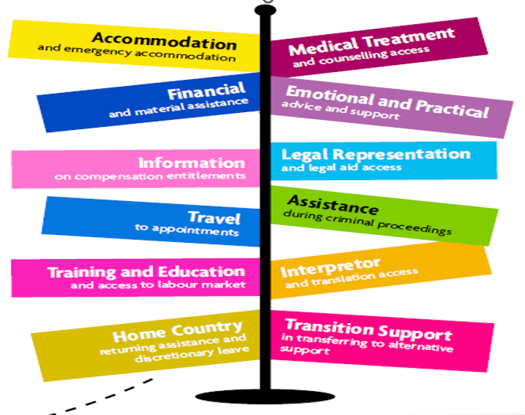
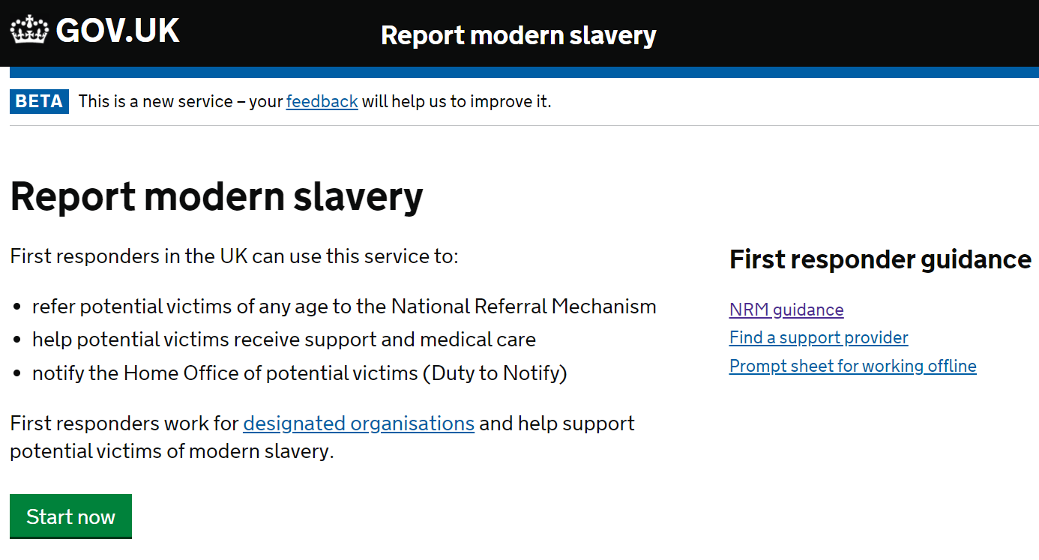
Action
Early identification, partnership working, and awareness are critical in disrupting these networks and safeguarding victims.
Share your concerns/ information on the multi-agency information submission form
Partnershipintelligence@northants.police.uk
Think NRM
Information will be assessed, recorded on police systems and acted upon as appropriate

